Slide 1

Data Structures
Lecture: AVL Tree
By
Asst. Professor
Lovely Professional University, Punjab

Slide 2
Motivation
When building a binary search tree, what type of trees would we like? Example: 3, 5, 8, 20, 18, 13, 22
3
5
13
8
5
20
13
18
3
8
18
22
20
22

Slide 3
Complete binary tree is hard to build when we allow dynamic insert and remove.
  We want a tree that has the following properties
    Tree height = O(log(N))
    allows dynamic insert and remove with O(log(N)) time complexity.
  The AVL tree is one of this kind of trees.
8
13
5
18
5
20
3
13
20
3
8
18
22
22

Slide 4
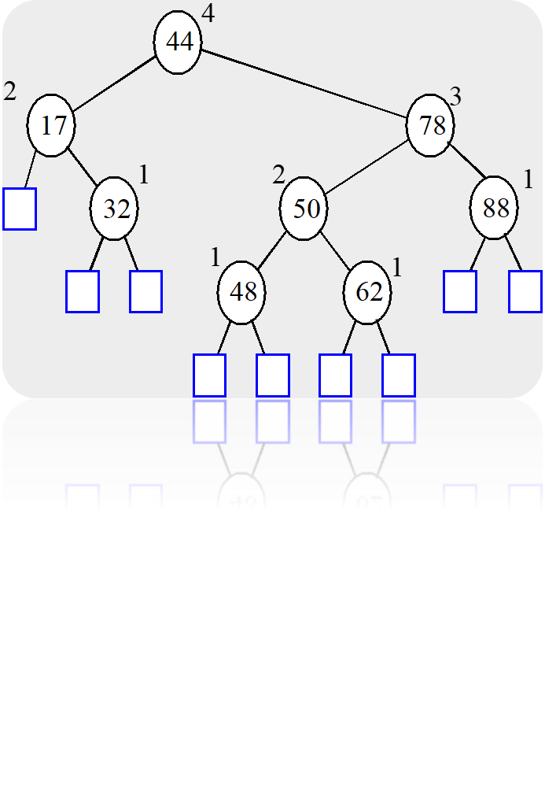
AVL (Adelson-Velskii and Landis) Trees
An AVL Tree is a binary search tree such that for every internal node v of T, the heights of the children of v can differ by at most 1.
An example of an AVL tree where the heights are shown next to the nodes:

Slide 5
AVL tree is a binary search tree with balance condition
  To ensure depth of the tree is O(log(N))
  And consequently, search/insert/remove complexity bound O(log(N))
Balance condition
  For every node in the tree, height of left and right subtree can differ by at most 1

Slide 6
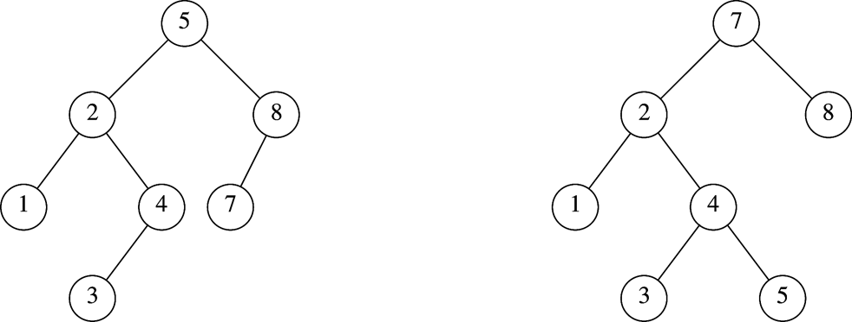
Which is an AVL Tree?

Slide 7
Balance Condition Violation
If condition violated after a node insertion
  Which nodes do we need to rotate?
  Only nodes on path from insertion point to root may have their balance altered
Rebalance the tree through rotation at the deepest node with balance violated
  The entire tree will be rebalanced
Violation cases at node k (deepest node)
  An insertion into left subtree of left child of k
  An insertion into right subtree of left child of k
  An insertion into left subtree of right child of k
  An insertion into right subtree of right child of k
  Cases 1 and 4 equivalent
    Single rotation to rebalance
  Cases 2 and 3 equivalent
    Double rotation to rebalance

Slide 8
AVL Trees Complexity
Overhead
  Extra space for maintaining height information at each node
  Insertion and deletion become more complicated, but still O(log N)
Advantage
  Worst case O(log(N)) for insert, delete, and search

Slide 9
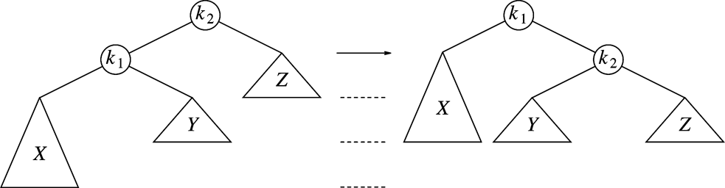
Single Rotation (Case 1)
Replace node k₂ by node k₁
Set node k₂ to be right child of node k₁
Set subtree Y to be left child of node k₂
Case 4 is similar

Slide 10
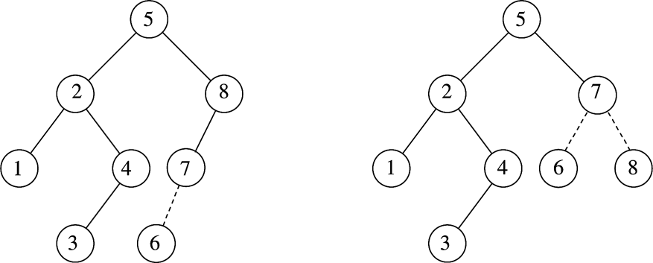
Example
After inserting 6
  Balance condition at node 8 is violated

Slide 11
Example
Inserting 3, 2, 1, and then 4 to 7 sequentially into empty AVL tree
3
2
2
1
3
1

Slide 12
Inserting 4
Inserting 5
2
1
3
4
2
2
1
3
4
1
4
5
3
5

Slide 13
4
Inserting 6
Inserting 7
2
2
5
1
4
1
3
6
3
5
6
4
4
2
6
2
5
1
3
5
7
1
3
6
7

Slide 14
Example
Continuing the previous example by inserting
  16 down to 10, and then 8 and 9
Inserting 16 and 15
4
4
2
6
2
6
1
3
5
15
1
3
5
7
7
16
16
15

Slide 15
Blank
Best case time complexity of traverse operation in AVL tree.
A. O(1)
B. O(log n)
C. O(n)
D. None of these

Slide 16
Inserting 14
4
4
2
7
2
6
1
3
6
15
1
3
5
15
14
16
7
16
5
14

Slide 17
Blank
Worst case time complexity of insertion of element in AVL tree.
A. O(1)
B. O(log n)
C. O(n)
D. None of these

Slide 18

Questions

Slide 19
Blank
http://www.motleytech.net/balanced-binary-tree-avl-tree-animation.html
https://www.cs.usfca.edu/~galles/visualization/AVLtree.html

